Slide 1

IST 402 Network Security Random Numbers, Base Encoding, Hashing, Ciphers LM1
Joe Oakes
Penn State Abington

Slide 2


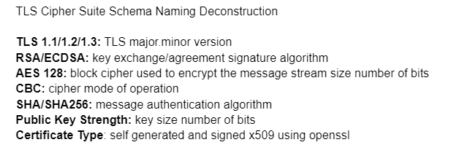
TLS Transport Layer Security
Transport Layer Security methods needed to perform
Key Exchange share a password
Encryption Ciphers
Block Chaining
Hashing check Integrity
Random number generation
Encoding
Certificates
Work with protocols
Work with handshaking

Slide 3
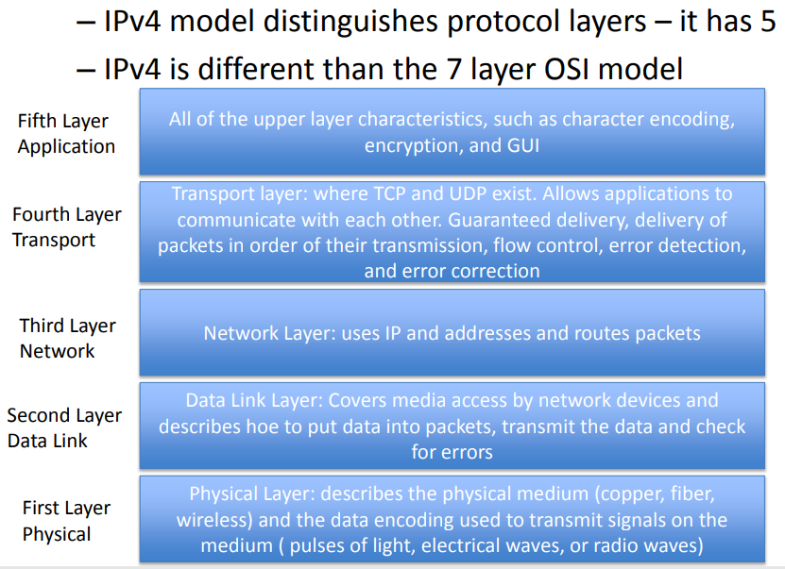
Networking Protocol Layers

Slide 4
Networking Protocol Layers
Sender Build the Stack –Create the Onion layers
Receiver Deconstruct the Stack – peel the Onion layers
IP
IP
TCP
TCP
HTTP
HTTP
TLS
TLS

Slide 5
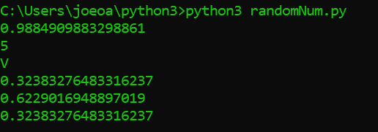
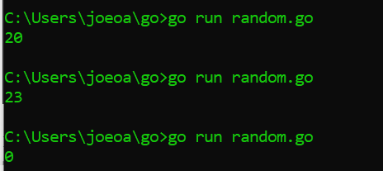
Generating Random Numbers
Random numbers are used with Encryption
We can get ranges of random numbers
We can set seeds and IV initialization vectors
Since the random method is just an algorithm we can set the Seed() value

Slide 6
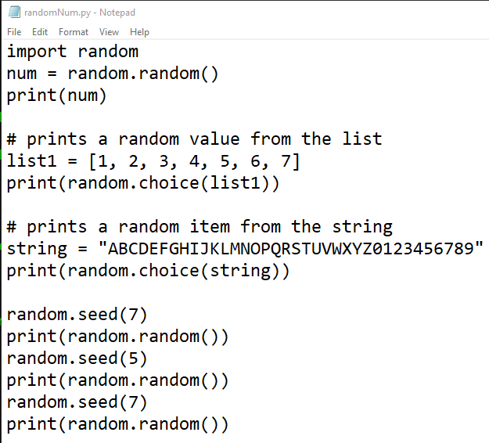
Python Code Example Generating Random Numbers & Strings

Slide 7
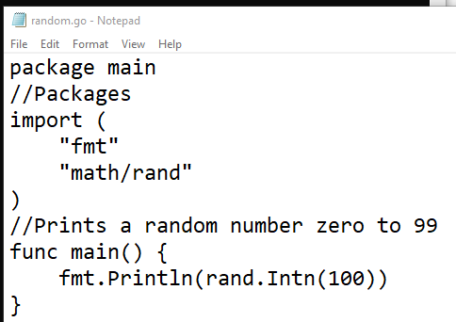
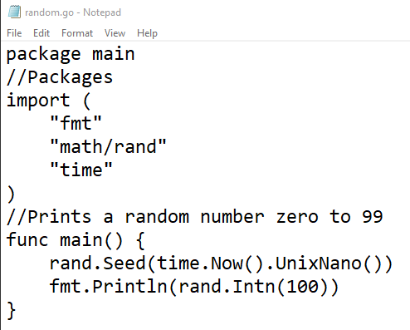
Go Code Example Generating Random Numbers

Slide 8
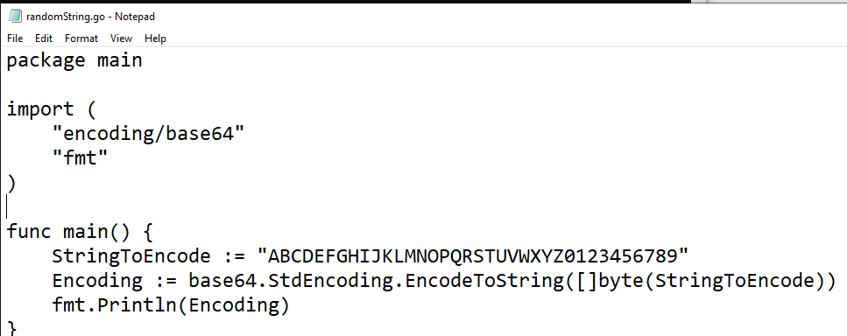

Go Code Example Generating Random Strings

Slide 9
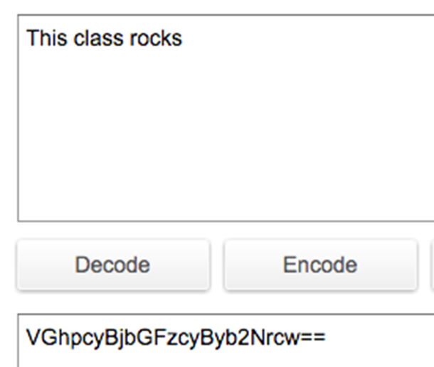

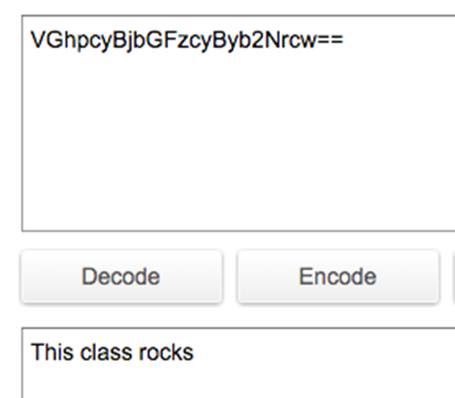
Base Encoding
Base64 encoding represents binary data (i.e., images, video, audio) in an ASCII string format
The input data is called the message and the output is called the hash
Is it used to protect the payload during transfer or storage so that meta characters are not interpreted

Slide 10
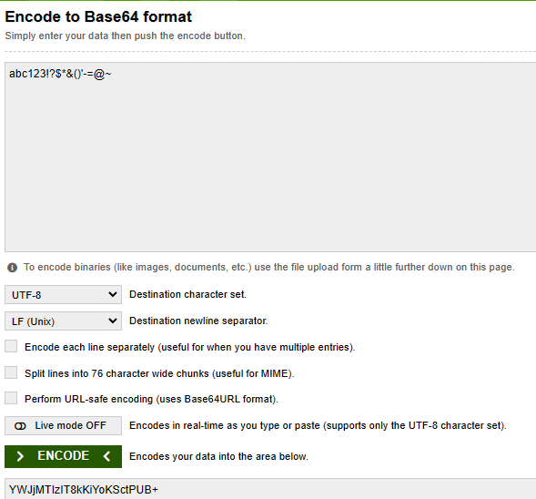
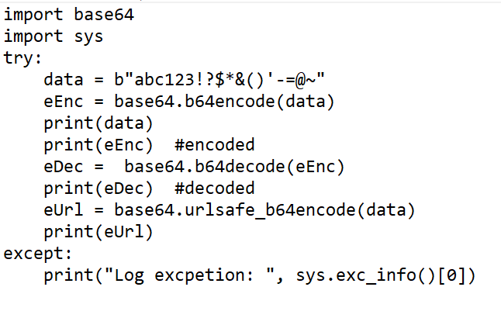
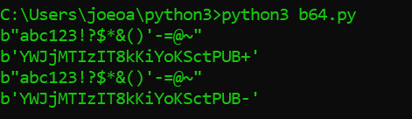
Python Code Example Base Encoding

Slide 11
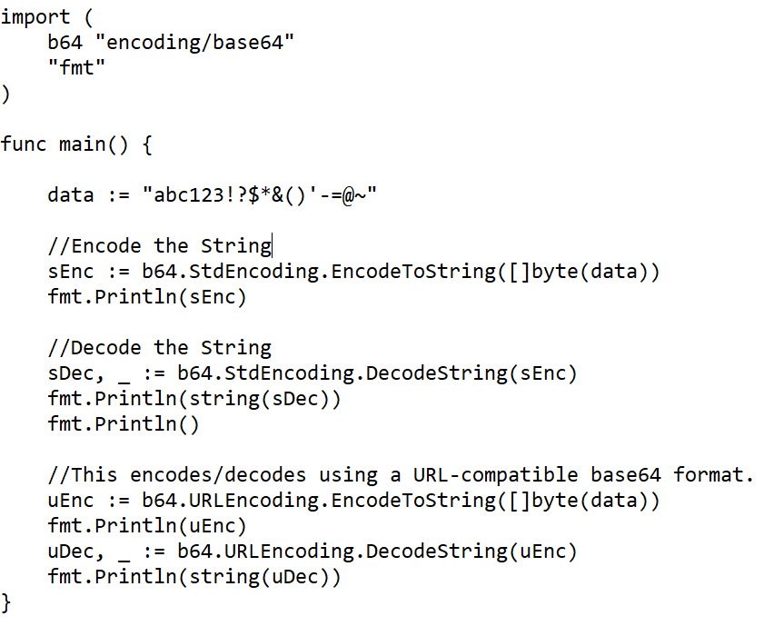
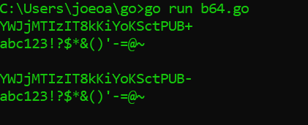
Go Code Example Base Encoding

Slide 12
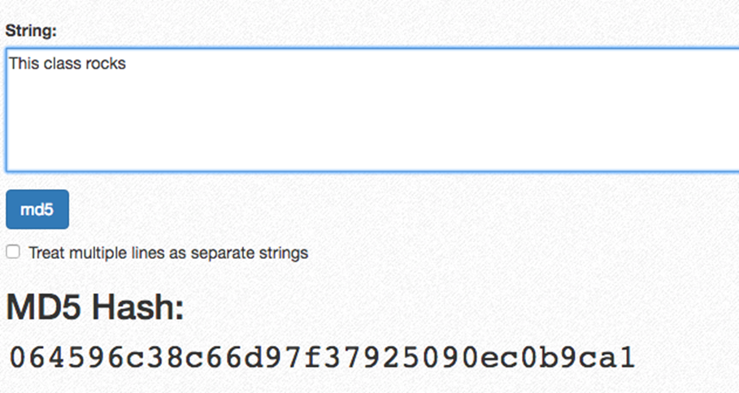
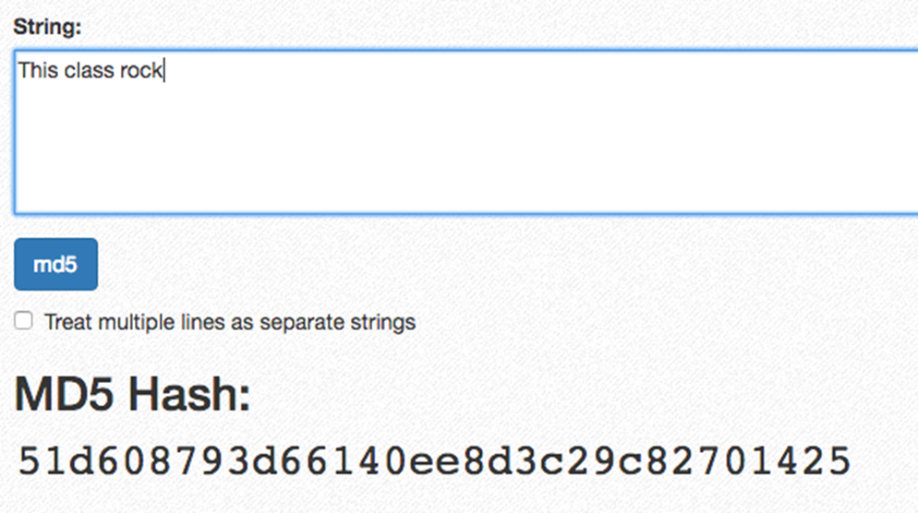
Message Digest Algorithms
MD5 (message digest) algorithm is a hash function that produces a 128-bit hash value and can be used as a checksum to verify the data integrity
Message digest algorithms are not resistant to brute-force attacks
Notice changing the string value of the message (from This class rocks to This class rock) will completely change the hash value
Can be used as a checksum for files to make sure they have not been tampered with or can be used for handling user’s one-way passwords

Slide 13
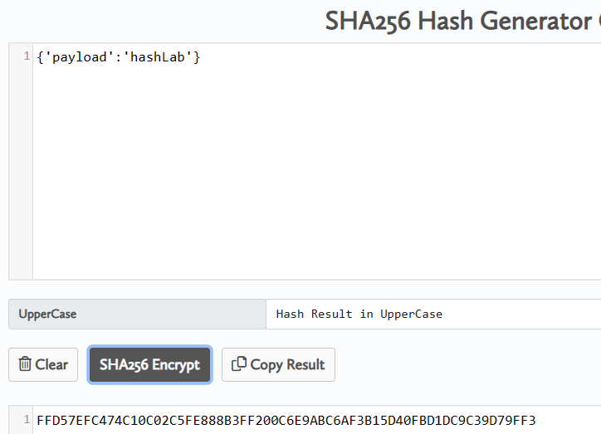
Message Digest Algorithms Usage
Can be used as a checksum for files to make sure they have not been tampered with or can be used for handling user’s one-way passwords

Slide 14
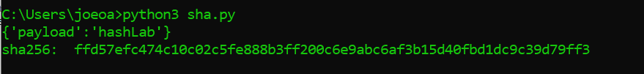
Python SHA 256 Code Example
import hashlib
try:
data = "{'payload':'hashLab'}"
checksum = hashlib.sha256(data.encode()).hexdigest()
print(data)
print("sha256: ", checksum)
except:
print("Log excpetion: ", sys.exc_info()[0])

Slide 15
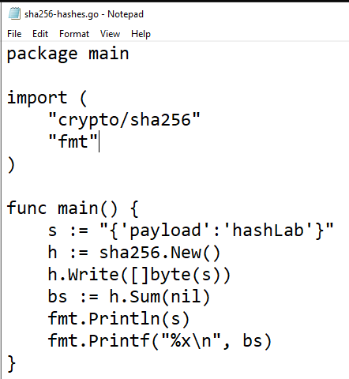

Go SHA256 Code Example
Write expects bytes, to convert a string to bytes use []byte(s)
Hash results as byte slice Sum used to append to existing byte slice

Slide 16
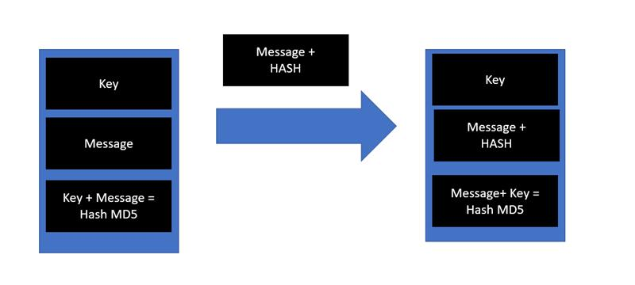
HMAC Hash based Message Authentication Code
For example: Notice the Key is never sent. It is known on both sides sender and receiver.
Sender: Key = "Joe", Message = "Hello", Key+Message = "JoeHello", MD5 hash for "JoeHello" = e67a55d9559a221afb6bdd5b8daeba08
Sender: sends: Message = "Hello" and Hash = e67a55d9559a221afb6bdd5b8daeba08
Receiver: Key = "Joe", Message = "Hello", Key+Message = "JoeHello", MD5 hash for "JoeHello" = e67a55d9559a221afb6bdd5b8daeba08
Receiver checks sent hash: e67a55d9559a221afb6bdd5b8daeba08 == e67a55d9559a221afb6bdd5b8daeba08 if yes everything is good

Slide 17

Python HMAC Code Example
import hashlib
try:
key = "keyword"
data = "{'payload':'hashLab'}"
payload = key+data
checksum = hashlib.sha256(payload.encode()).hexdigest()
print(data)
print("sha256: ", checksum)
except:
print("Log excpetion: ", sys.exc_info()[0])

Slide 18
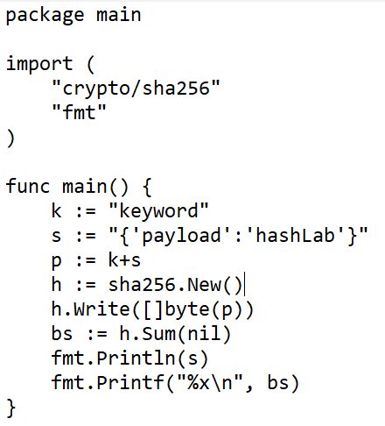

Go HMAC Code Example
packages
Shown as a hex format

Slide 19
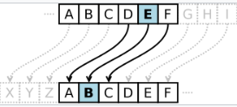


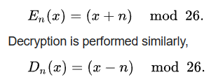
Brute Force Attack
Caesar cipher: very simple encryption technique
It is a type of substitution cipher in which each letter in the plaintext is replaced by a letter of some fixed positions
The key is the shift position for the example here is 3. Notice T becomes a Q, and H becomes a E
If you don't know the key is 3 you just keep shifting the alphabet over and looking at the results 26 times
You can use Modular arithmetic
There are other substitution ciphers: Vigenere Cipher, ROT13 system

Slide 20
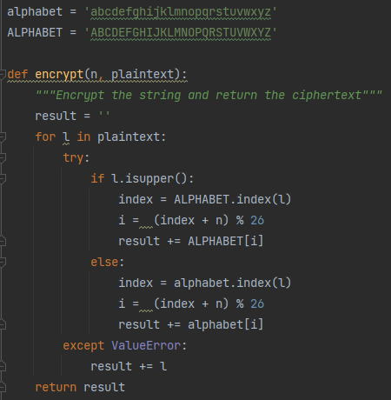
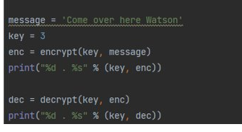
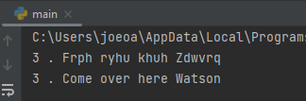
Python Code Example Caesar Cipher Encryption

Slide 21
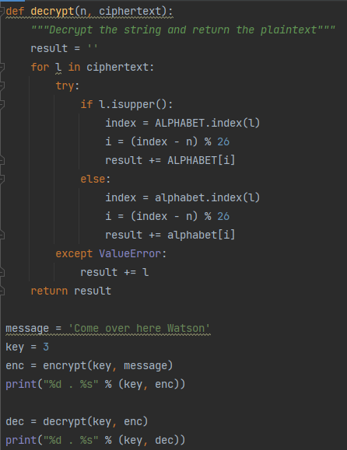
Python Code Caesar Cipher Example Decryption

Slide 22
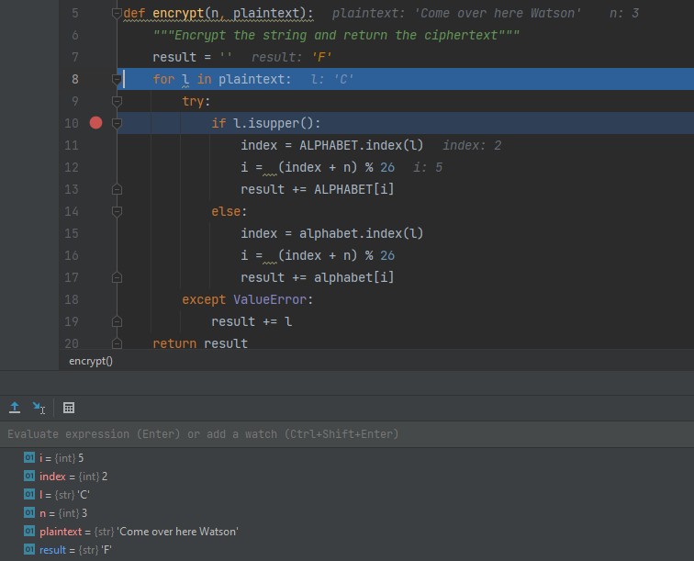

Python Code Caesar Cipher Example
For 'C' character is it index (zero based) 2 plus the key 3
2+3 = 5
5 Mod 26 = 5
Index 5 is the letter F

Slide 23
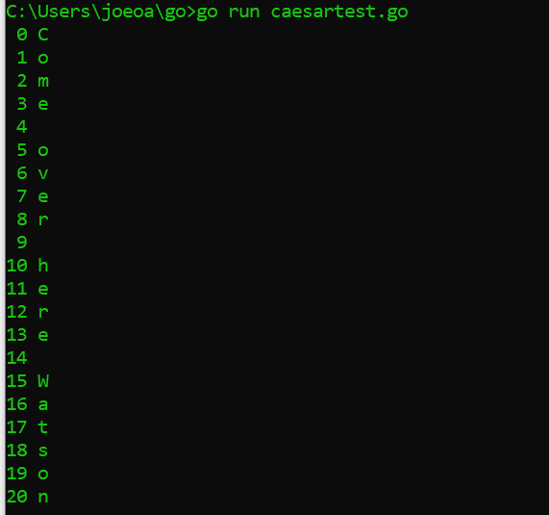
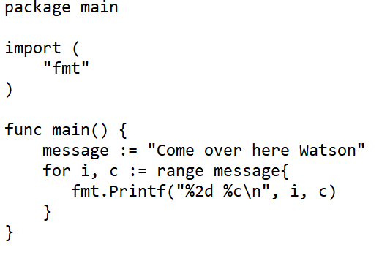
Go Code Example Caesar Cipher Encryption
Step 1: Understand how to iterate through a string in go

Slide 24
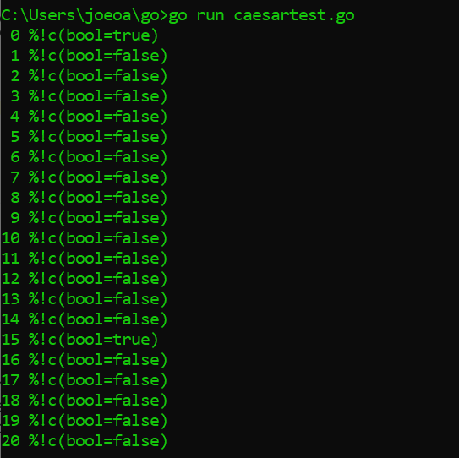
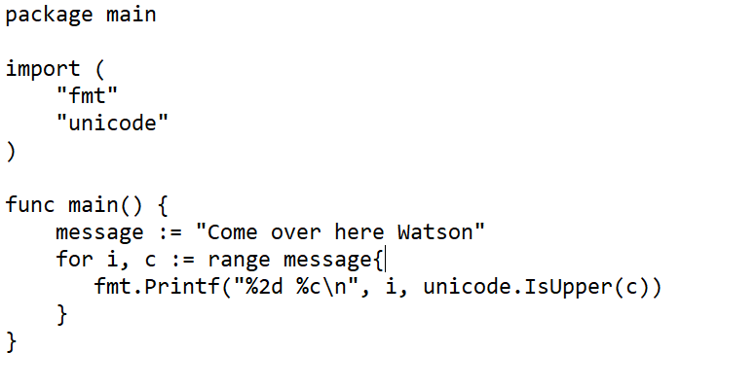
Go Code Example Caesar Cipher Encryption
Step 2: Determine the character case
message := "Come over here Watson"

Slide 25
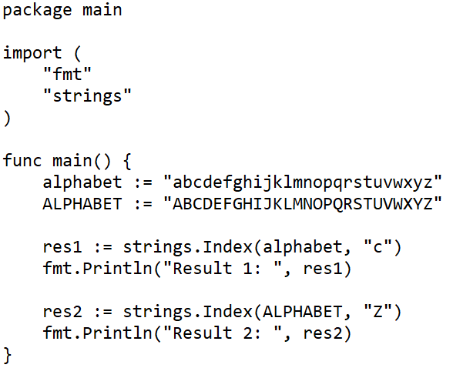
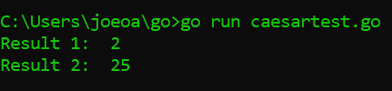
Go Code Example Caesar Cipher Encryption
Step 3: Find a character in the string

